Slide 1
Cybersecurity CSCI 2413 Mid-Term Review

Slide 2
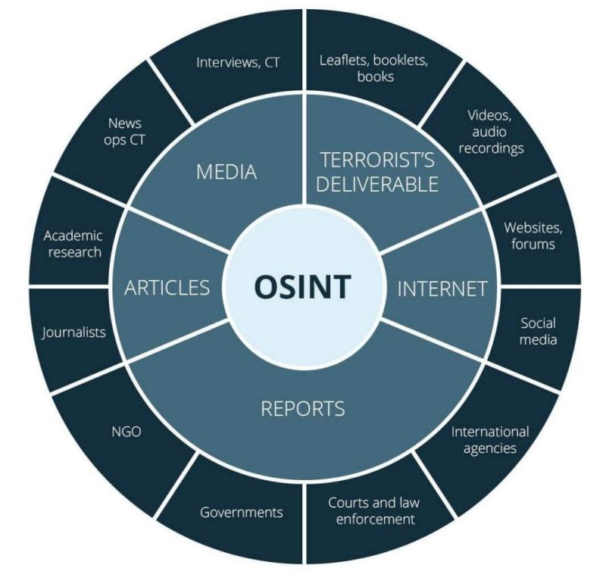
OSINT (Open-Source Intelligence)
Open-Source Intelligence (OSINT) – collecting and analyzing publicly available information to gather insight and information on a target

Slide 3
OSINT Workflow/Steps
Planning and Direction: Establish clear objectives by defining what information is needed and why.
Collection: Data gathering from public sources, social media, public records…. Manual and automated methods are used to gather the data.
Processing and Organization: Filter the Raw data for only relevant information and remove duplicates this is mainly a manual process.
Notes:
Explain what false positives are and what false negatives are.

Slide 4
OSINT Workflow/Steps – cont.
Analysis and Correlation: Identify patterns, relationships, and trends. Corroborate findings with multiple sources to ensure accuracy.
Dissemination: Report the final findings in a structured way (Report, Briefing) to the relevant stakeholders.
Notes:
Explain what false positives are and what false negatives are.

Slide 5
OSINT Targets
Individuals
Organizations and Businesses
Critical Infrastructure
Cybersecurity and Threat Intelligence
Governments and Nations
Public Health
Notes:
Explain what false positives are and what false negatives are.

Slide 6
Sock Puppet
Sock Puppet is a covert account that is not related to your identity.
This will protect you from revealing your true identity when performing SOCMINT (Social Media Intelligence)
When doing this for an investigation/pentest you want to do this from a Virtual Machine (VM) using a VPN (Virtual Private Network)
We will be setting them up later in the semester.
Notes:
List pros and cons of this type of anomaly detection.

Slide 7
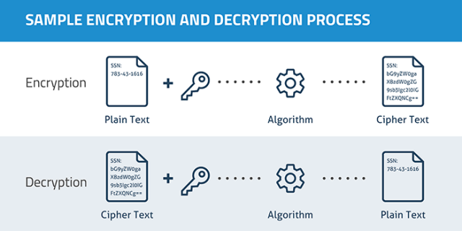
Cryptography Basics
Encryption
Algorithm scrambles plain text
Sender and receiver agree on algorithm
Message difficult to re-create without protocol
Decryption
Reversal of the scrambling protocol to make the message comprehensible

Slide 8
Cryptography Basics (cont.)
Two basic types
Transposition
Rearranging each letter with a different letter
Substitution
Replaces each letter with a different letter
Two types of substitution
Single/symmetric key encryption
Stream
Block
Public/asymmetric key encryption

Slide 9

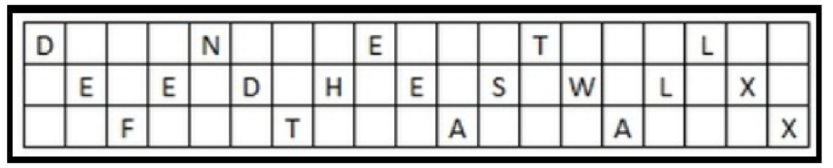
Transposition Cipher
Scytale
Rail Fence
Message: “Defend the east wall” with a key of 3
The cipher text is read off row by row to get: DNETLEEDHESWLXFTAAX

Slide 10
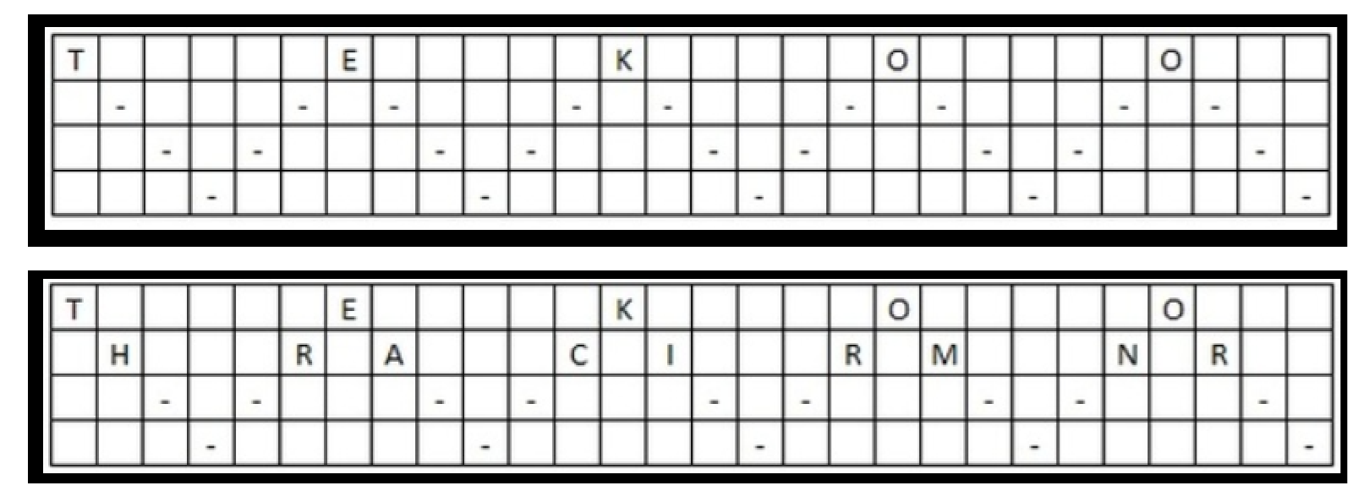
Transposition Cipher
Decrypt:
TEKOOHRACIRMNREATANFTETYTGHH Encrypted with a key of 4

Slide 11
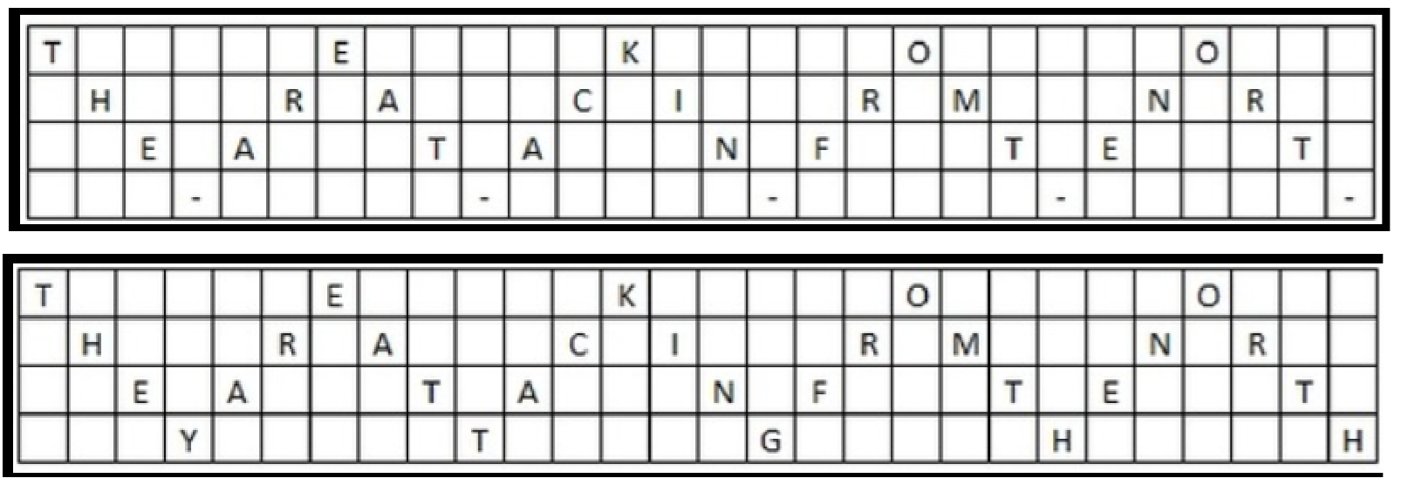
Transposition Cipher
Received:
TEKOOHRACIRMNREATANFTETYTGHH
Encrypted with a key of 4
“They are attacking from the north”

Slide 12
Substitution Ciphers
Old as written communication and war
Caesar Cipher
Shift cipher
Example Key +2
Cleartext = HELLO WORLD
ABCDEFGHIJKLMNOPQRSTUVWXYZ
CDEFGHIJKLMNOPQRSTUVWXYZAB
Cipher Text = JGNNQ YQTNF

Slide 13
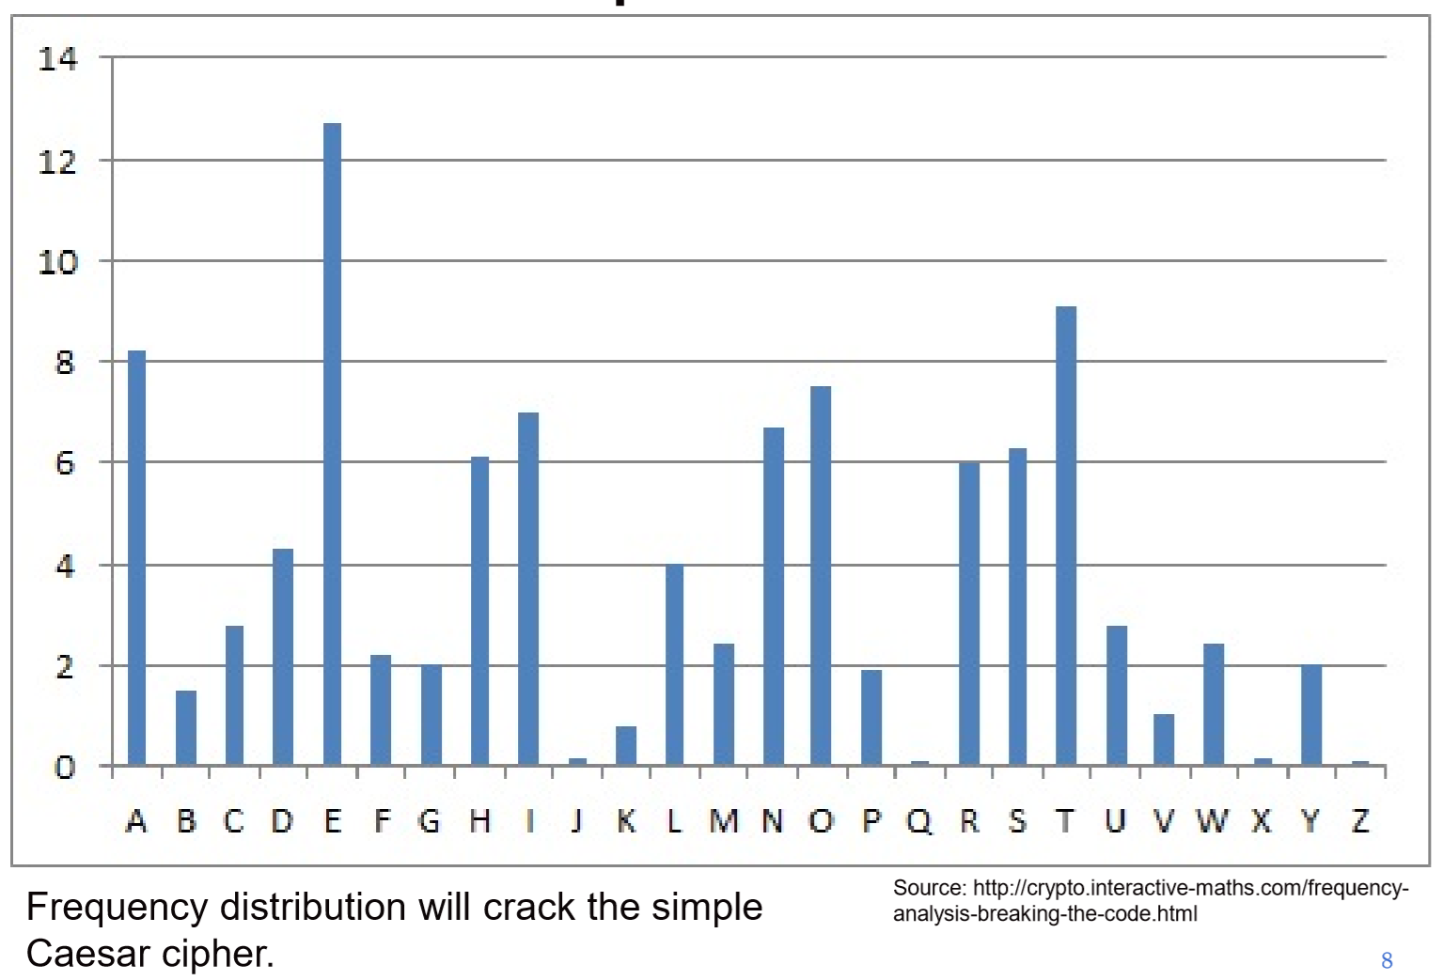
Substitution Ciphers

Slide 14
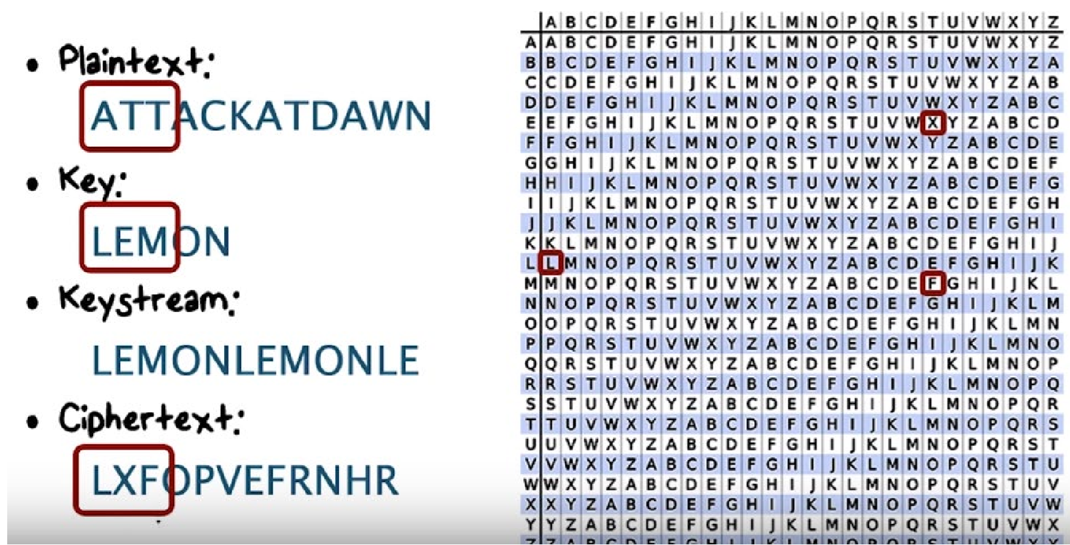
Vigenere Cipher

Slide 15
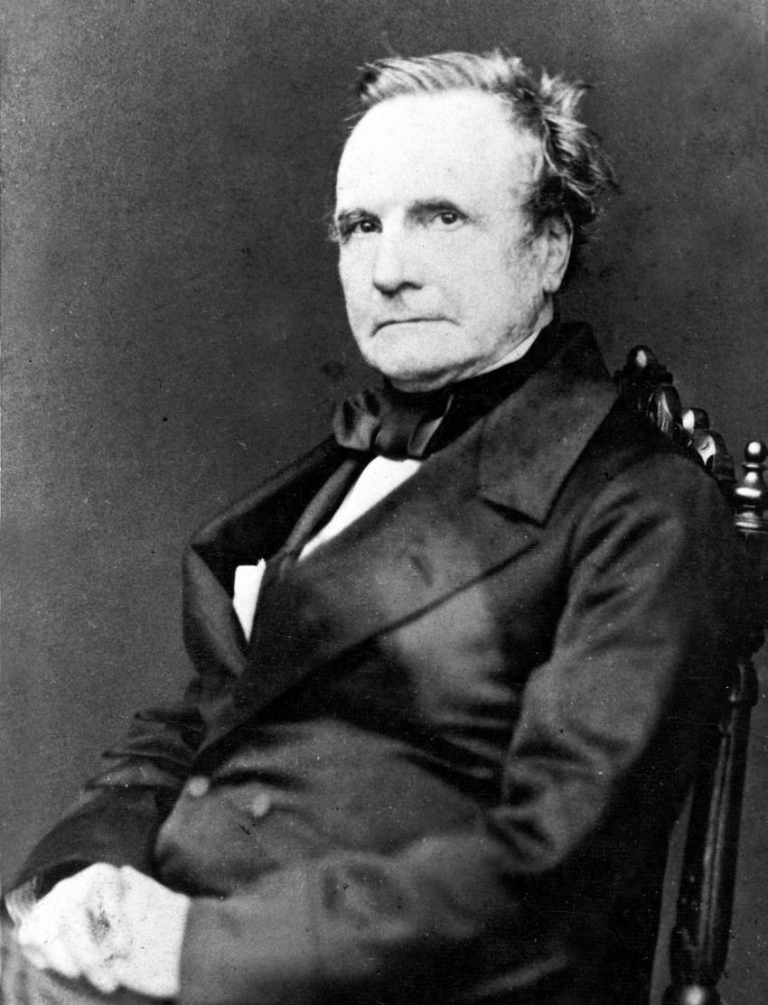

Charles Babbage
In 1854 Babbage broke Vigenere Cipher

Slide 16
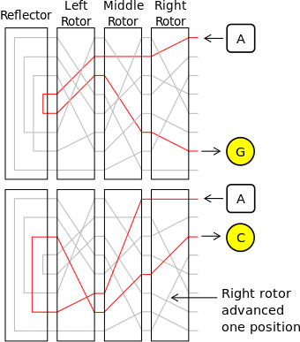

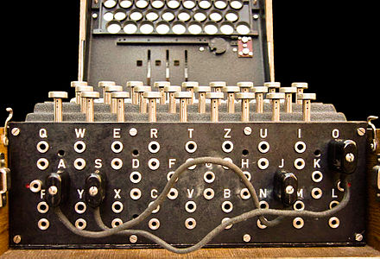
Enigma
Arthur Scherbius – created in 1918
https://www.youtube.com/watch?v=ybkkiGtJmkM

Slide 17

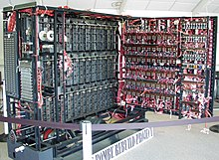
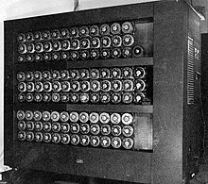
Alan Turing
Created first “Bombe” in 1940s
This helped crack the Enigma codes

Slide 18

Alan Turing – “Turning Test”
The interviewer asks the same question of a computer and a human to determine if you talking to a computer or human.

Slide 19
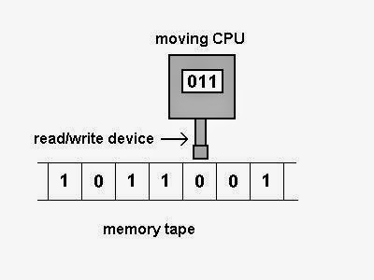
Alan Turing – 6 Primitives
Wrote about the 6 basic operations (primitives) to be considered a software language.
- Right: Move the Machine’s head to the right of the current square
- Left: Move the Machine’s head to the left of the current square
- Print: Print a symbol on the current square
- Scan: Identify any symbols on the current square
- Erase: Erase any symbols presented on the current square
- Nothing/Halt: Do nothing

Slide 20
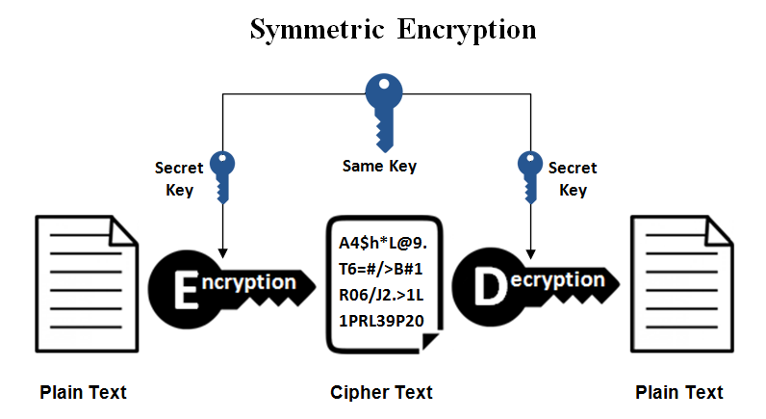
Symmetric Encryption

Slide 21
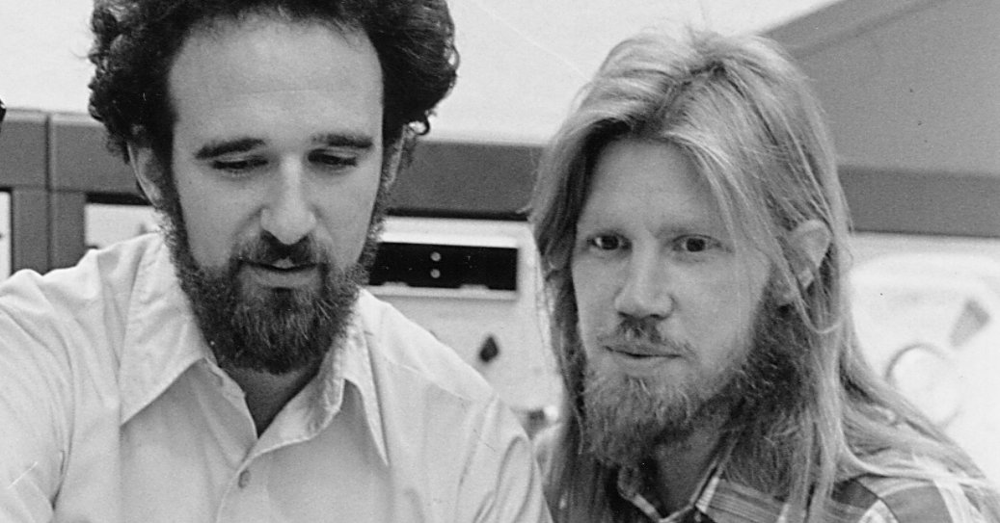
Diffie Hellman
Martin Hellman
IBM Watson Research Center
1968 - 1969
Whitfield Diffie
Stanford AI Lab
1974

Slide 22
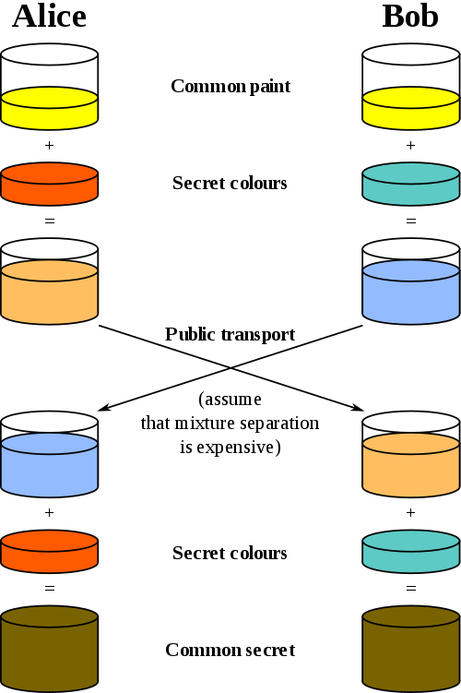
Diffie Hellman Example (Colors)

Slide 23
Diffie Hellman Example (Numbers)
Alice |  | Bob |  | Eve
Known | UN | Known | UN | Known | UN
p=23 |  | p=23 |  | p=23
g=5 |  | g=5 |  | g=5
a=6 | b | b=15 | a |  | a,b
A=5ª mod 23 |  | B = 5^{b} mod 23
A=5⁶ mod 23 = 8 |  | B=5¹⁵ mod 23 = 19
B=19 |  | A=8 |  | A=8, B=19
S=Bª mod 23 |  | S=A^{b} mod 23
S=19⁶ mod 23 = 2 |  | S=8¹⁵ mod 23 = 2 |  |  | S
Public Key Cryptography

Slide 24
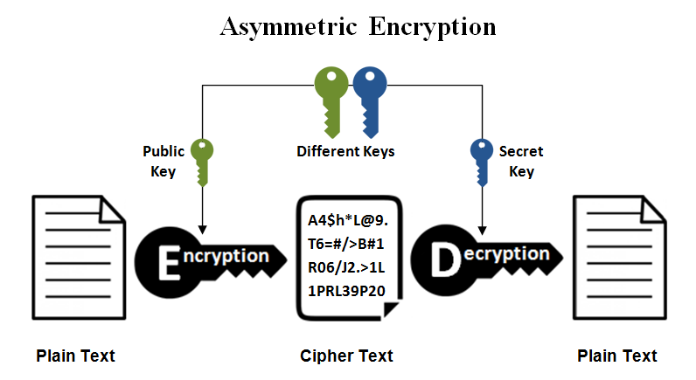
Asymmetric Encryption

Slide 25
Certificate Authorities (CA)
Primary role is to digitally sign and public the public key of a given user
Registration Authority (RA) is often used to handle verification prior to certificates being issued
Public Key Infrastructure (PKI)
An arrangement that binds public keys with respective user identities by means of a CA
A network of trusted CA servers

Slide 26
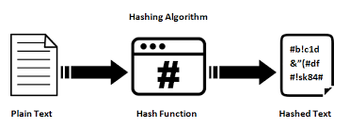
Hashing
Takes a variable-size input and returns a fixed-size string
The value returned is called the hash value
Hashing is one-way; you cannot un-hash something
Hashing is how Windows stores passwords
Salt refers to random bits that are used as one of the inputs to the hash
Complicates dictionary and rainbow table attacks

Slide 27
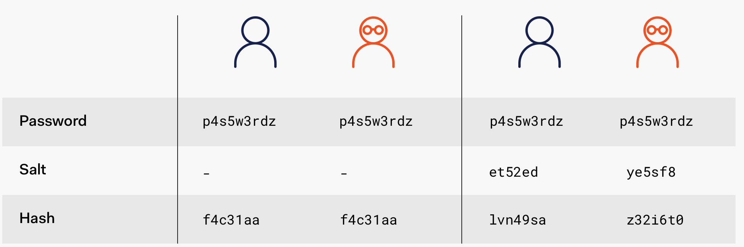
Salting
Salting uses a randomly generated string used with the has so each hashed password will be unique even if the passwords are the same.

Slide 28
Hashing Methods
Secure Hash Algorithm (SHA)
Most widely used
SHA-1, SHA-2, SHA-3, SHA-256, SHA-512
MD5
Not collision resistant
RACE Integrity Primitives Evaluation Message Digest (RIPEMD)

Slide 29
Steganography
Steganography is the art and science of writing hidden messages in such a way that nobody other than the sender and intended recipient suspects the existence of the message
Message is often hidden in some other file such as a digital picture or audio file
Messages do not attract attention to themselves

Slide 30

Introduction
Social engineering is the psychological manipulation of people into performing actions or divulging confidential information.

Slide 31
Attacks - Techniques
Commitment
Authority
Reciprocation
Reverse Engineering
Likening
Scarcity
Notes:
Explain what false positives are and what false negatives are.

Slide 32
Commitment
Commitment attacks occur when the attacker tricks the victim into making a promise which he or she will then feel obligated to keep
Victim do not want to be untrustworthy
Car Deals and Furniture stores use these tactics
Conformity is a special type of commitment leveraging an implied commitment made by society rather than by the individual
Waiter provides poor service then collects the tip in person

Slide 33
Authority
Authority is the process of an attacker assuming a role of authority which he does not possess.
3 Types
Impersonation – pretending to be some they are not
Diffusion of Responsibility – involves an attacker manipulating the decision-making process from one that is normally individual to one that is collective
Reciprocation – occur when an attacker gives the victim a gift and the victim feels a strong social pressure to return some type of favor.
Notes:
List pros and cons of this type of anomaly detection.

Slide 34
Reverse Social Engineering
Reverse Social Engineering is an attack where the aggressor tricks the victim into asking him for assistance in solving a problem.
1) Sabotage – Attacker creates a problem compelling the victim to action
2) Advertise – Attacker advertises his/her willingness and ability to solve the problem
3) Assist – Attacker requests assistance from the victim to solve the problem. Typically requesting passwords or access to the users system.

Slide 35
Likening
Likening is the process of an attacker behaving in a way to appear similar to a member of a trusted group.
Political groups
Religious groups
Hobbies
Gain confidence getting to know you and the group

Slide 36
Scarcity
Scarcity attacks occur when the attacker is able to introduce the perception of scarcity of an item that is a high perceived value.
Rushing – involves then attacker putting severe time constraints on a decision

Slide 37
Defenses
The simplest and most effective defense against social engineering attacks is EDUCATION.
Training – Repeat Often
Reaction – recognize the attack and moving to more alert state.
Inoculation – making attack resistance a normal part of the work experience.
Notes:
Discuss the three modes of operation with the following three slides.

Slide 38
Physical Security Attacks
Tailgating – seeking entry to a restricted area secured by walking in after someone else has opened the door
Shoulder Surfing – Looking over someone's shoulder to see them type their password or read a confidential document
Leaving Computer Unlocked – Never leave your computer unlocked (TRUST NO ONE)
Notes:
Discuss the differences between sniffer mode and packet logging.
You might also include other examples of sniffer programs that are on the market.

Slide 39
What do the attackers want?
Personally Identifiable Information (PII)
Name – Full Name, maiden name, mother’s maiden name
Personal identification numbers – Social Security Number (SSN), Passport Number, Drivers License Number, Taxpayer ID
Personal Address – Street address, city, state, zip
Personal Phone #/Email
Personal Characteristics – Photograph, fingerprints, handwriting
Biometric data – retina scans, voice signatures or facial geometry
Financial Data – Bank accounts, Credit cards, Tax records
Notes:
Explain that Snort’s network intrusion-detection learns from experience and can modify rules based on certain behavior. This is what is meant by heuristic.
Also point out that it is command-line-based; therefore, administrators must be familiar with documentation and the commands used in Snort. This is not intuitive.

Slide 40
Other Shared PII
Date of Birth
Place of Birth
Business Phone, Email, Address
Race
Religion
Employment Information
Medical Information
Education Information
Financial Information
Notes:
Explain that Snort’s network intrusion-detection learns from experience and can modify rules based on certain behavior. This is what is meant by heuristic.
Also point out that it is command-line-based; therefore, administrators must be familiar with documentation and the commands used in Snort. This is not intuitive.

Slide 41
Phishing
Phishing is the fraudulent attempt to obtain sensitive information such as usernames, passwords, bank account info….
Spear Phishing – directed at specific individuals or companies
Whaling – Targets a specific individual usually a senior executive (Jeff Bezos)
Vishing – Voice call
Smishing – SMS/Text Message

Slide 42
HIPAA
Health Insurance Portability and Accountability Act (HIPAA) of 1996
Designed to protect the privacy and security of certain health information.
https://www.hhs.gov/hipaa/for-professionals/security/laws-regulations/index.html
Notes:
Explain that Snort’s network intrusion-detection learns from experience and can modify rules based on certain behavior. This is what is meant by heuristic.
Also point out that it is command-line-based; therefore, administrators must be familiar with documentation and the commands used in Snort. This is not intuitive.

Slide 43
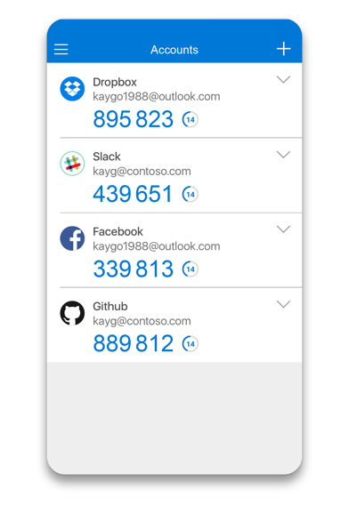
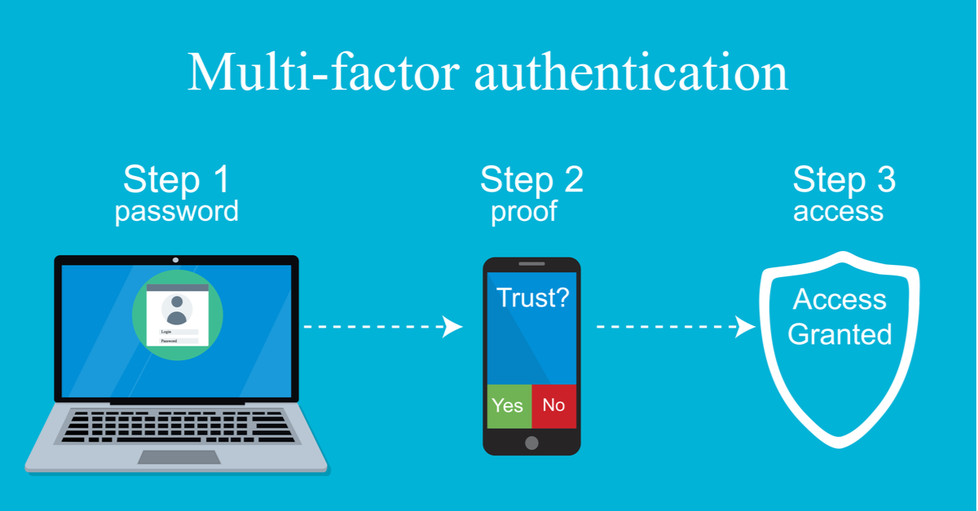
Multi-factor Authentication (MFA)

Slide 44
Dictionary Attack
Dictionary Attack is a type of brute-force cyberattack where an attacker uses pre-compiled lists of common passwords, keyboard patterns, common words, and previously leaked credentials to try to break into a user account.

Slide 45
Attack Types
Rule-based attack makes modifications to the words from a dictionary file, replacing common characters like “a” and “@” that follow password patterns
Mask attack is an optimized brute-force that reduces the search by exploiting known information about the passwords format or length.

Slide 46
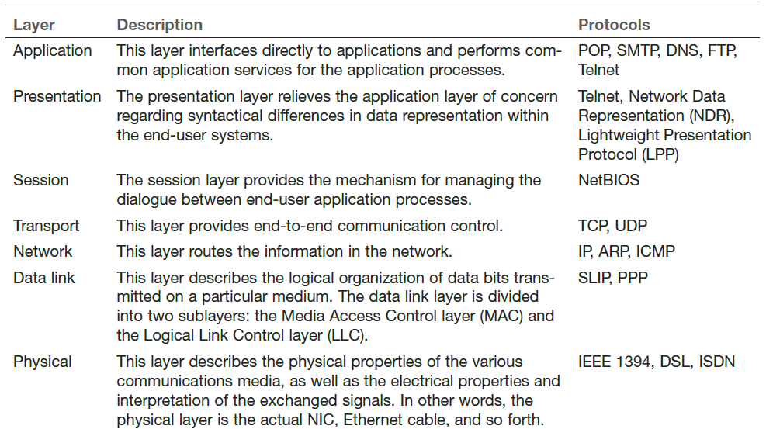
The Open Systems Interconnect (OSI) Model
Please Do Not Tell Secret Passwords Anytime

Slide 47
Router, Switch and Hub
Router – forwards data packets along networks. It is connected to at least two networks, commonly two LANs or WANs.
Switch – device that filters and forwards packets between LAN segments. (Data Link Layer)
Hub – connect point for devices in a network connecting segments of a LAN. (Physical Layer)

Slide 48
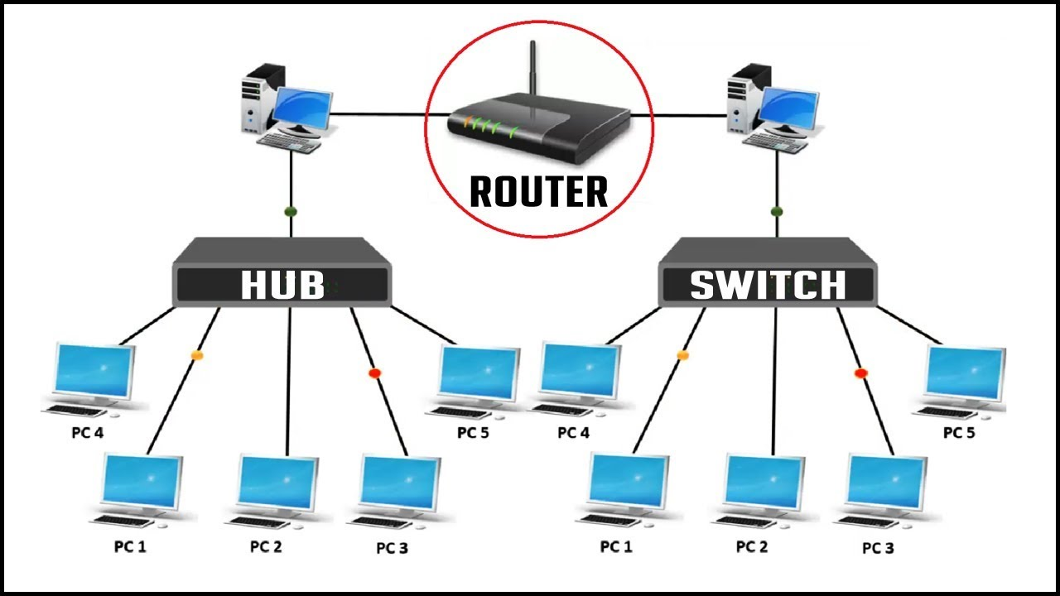
Router, Switch, and Hub

Slide 49
IP Addresses
IPv4 is a series of four three-digit numbers separated by periods: 107.22.98.129
Each set of digits range between 0 and 255
0.0.0.0 to 255.255.255.255
Certain ranges are private, for use within networks
IPv6 uses a 128-bit address and hex numbering. Example: 3FFE:B000:800:2:C

Slide 50
IP Ranges (First Byte)
Class A (0 - 126) - Extremely large networks (All Class A IPs have been assigned)
Class B (128 - 191) - Large corporate and government networks (All Class B Ips have been assigned)
Class C (192 - 223) – Most common IP ranges (Used by ISP)
Class D (224 – 247) – Reserved for multicasting (transmitting different data on the same channel)
Class E (248 – 255) – Reserved for experimental use

Slide 51
IP Addresses
Private Networks
10.0.0.10 – 10.255.255.255
172.16.0.0 – 172.31.255.255
192.168.0.0 – 192.168.255.255
Local Host (localhost)
127.0.0.1

Slide 52
Uniform Resource Locators
URLs are text-based web addresses, such as www.okcu.edu that translate into Internet IP addresses 165.227.49.159
Translation is performed by Domain Name Service (DNS) servers

Slide 53
MAC Addresses
MAC addresses are unique hardware addresses
Every NIC in the world has a unique MAC address
Six-byte hexadecimal numbers
Address Resolution Protocol (ARP) converts IP addresses to MAC addresses

Slide 54
Protocols/Ports
Protocol | Port
FTP | 20, 21
SSH | 22
Telnet | 23
SMTP | 25
DNS | 53
HTTP | 80
POP3 | 110
LDAP | 389
HTTPS | 443
RDP | 3389

Slide 55
Basic Network Utilities
ipconfig
ping
tracert
netstat

Slide 56
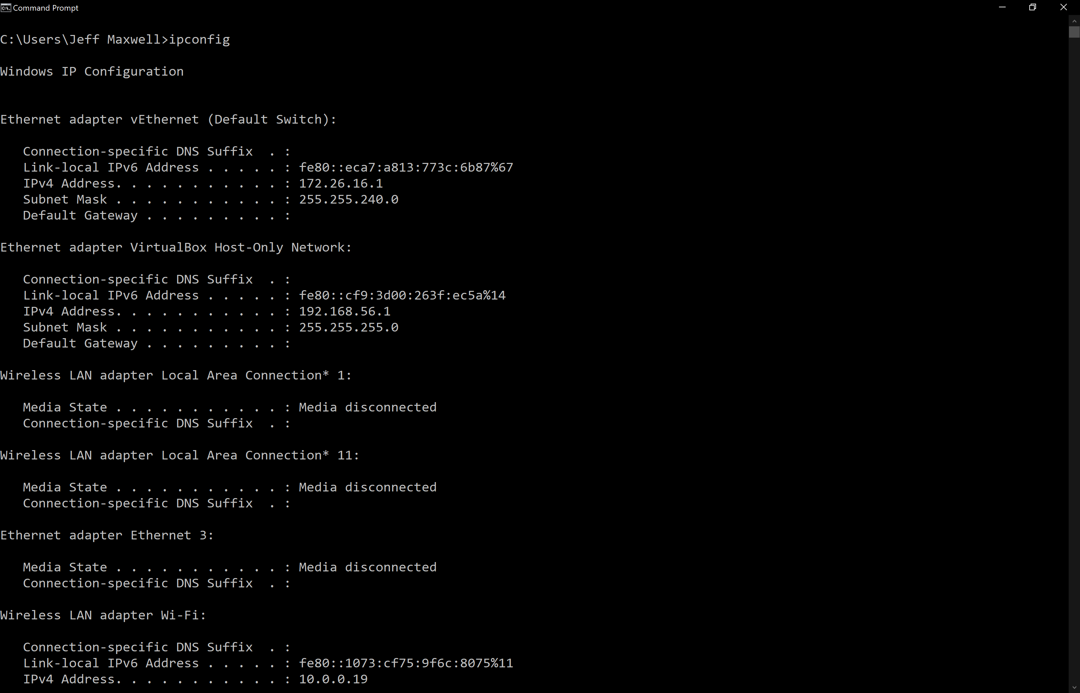
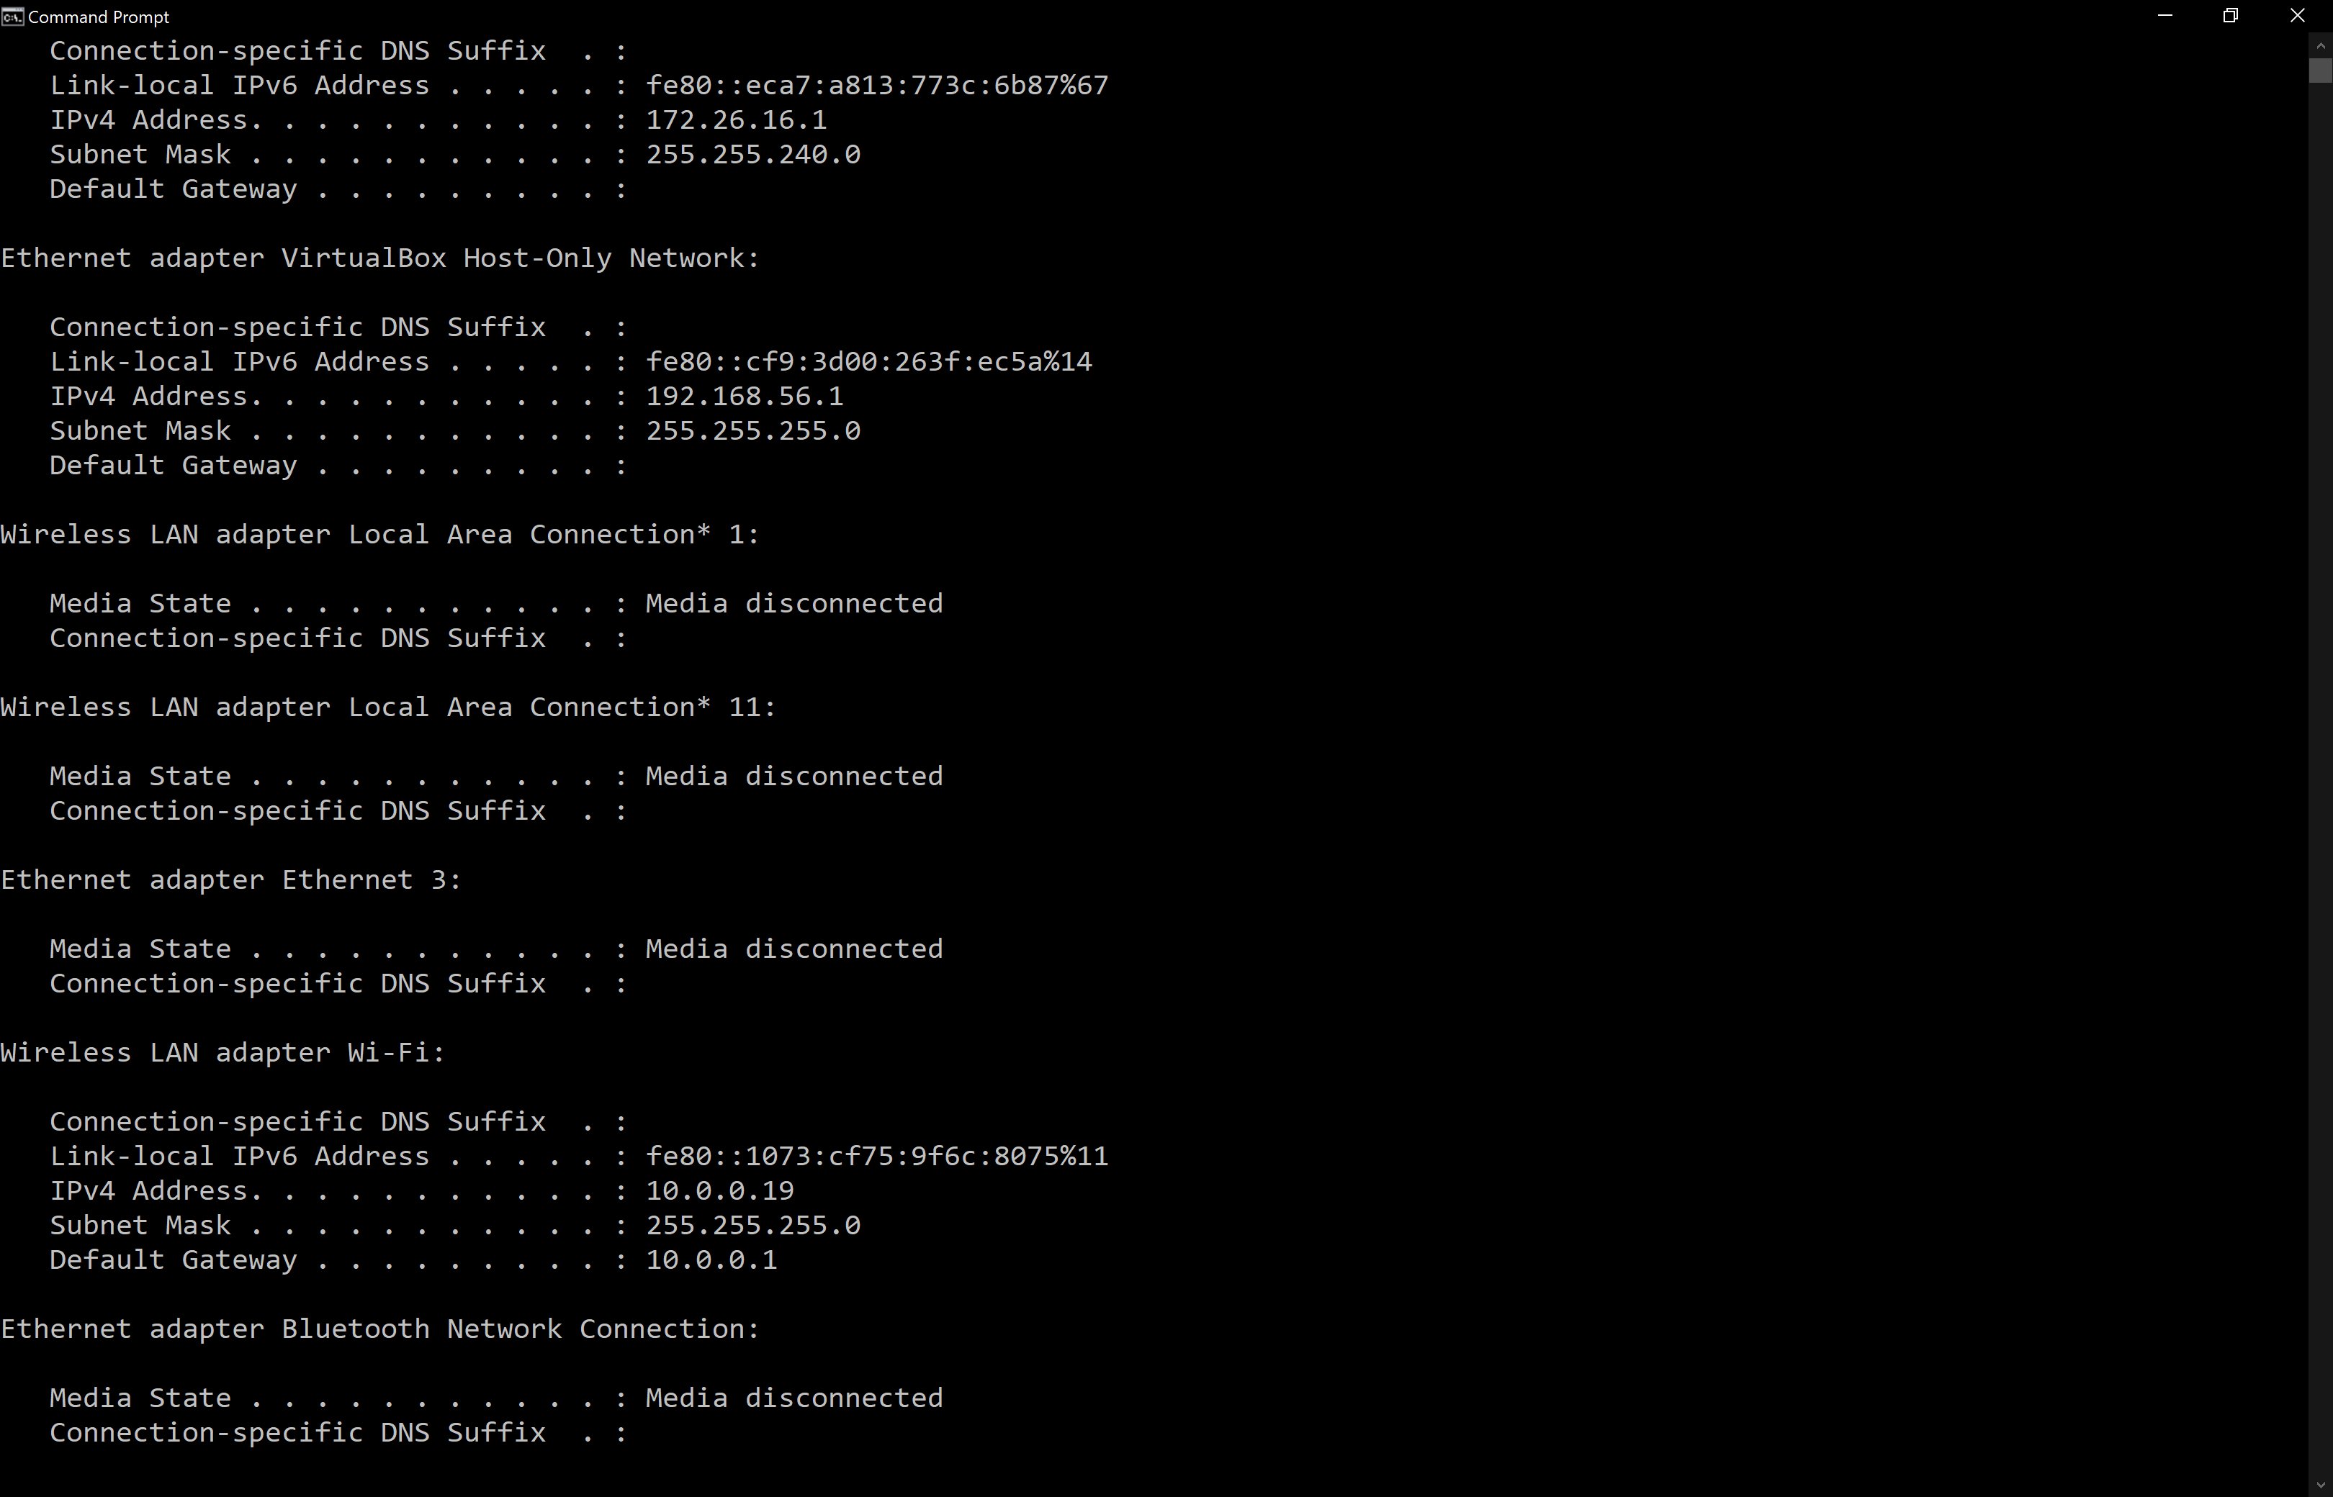
Basic Network Utilities
ipconfig (PC)
Or
ifconfig (Mac/Unix)

Slide 57
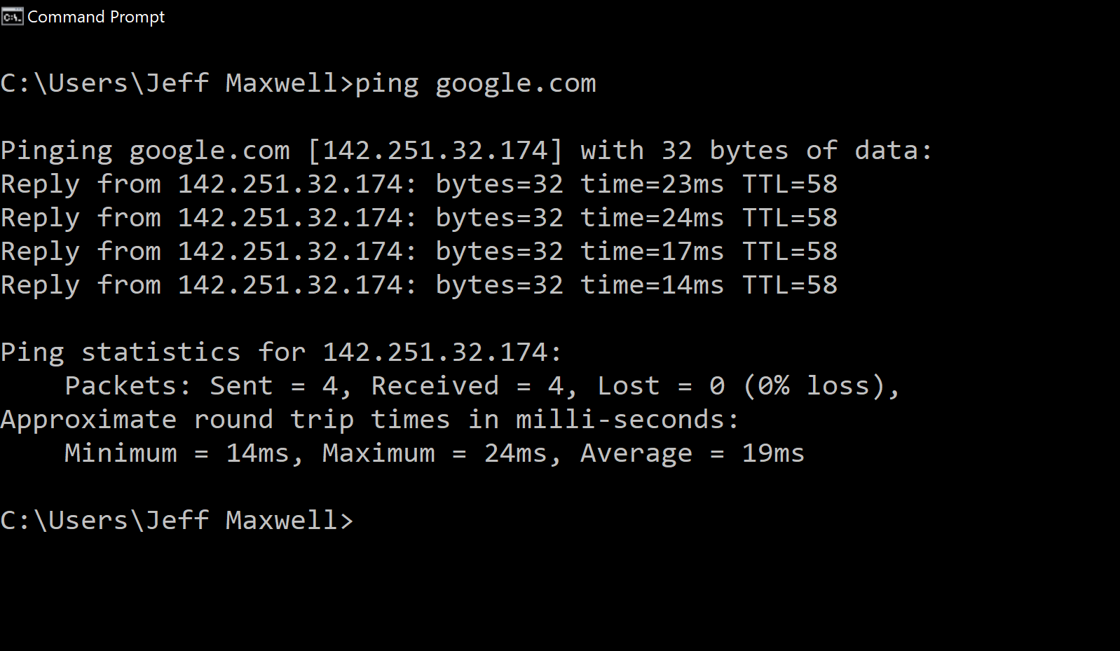
Basic Network Utilities
ping

Slide 58
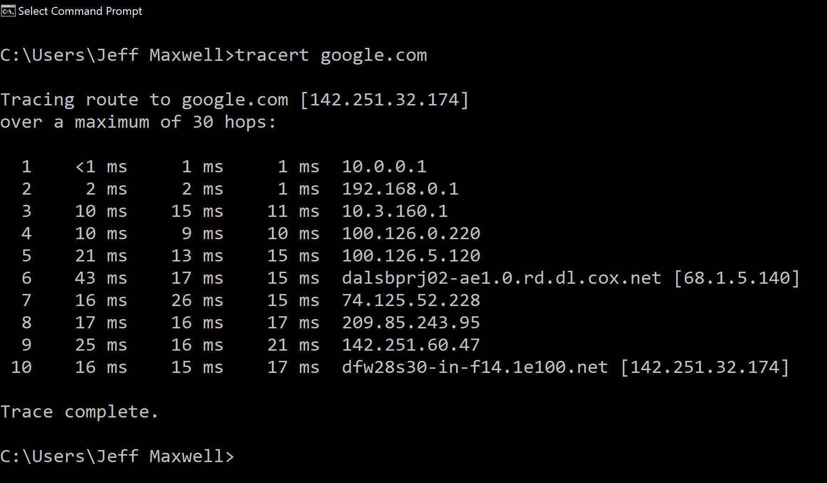
Basic Network Utilities
tracert

Slide 59
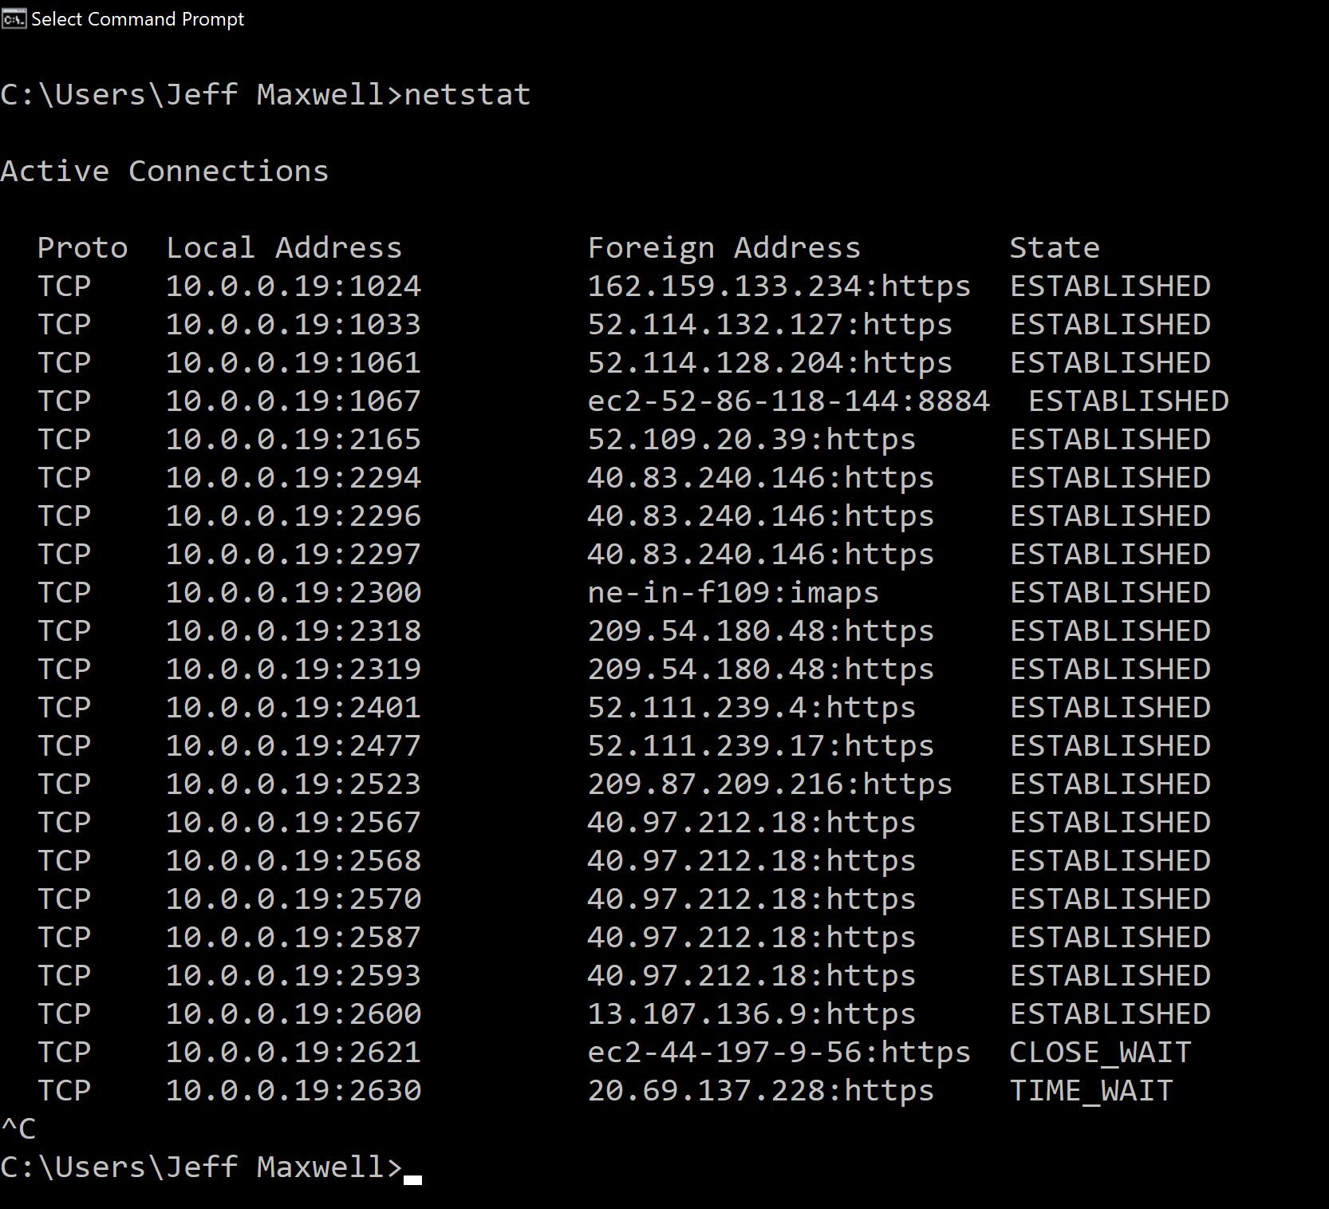
Basic Network Utilities
netstat
https://infotracer.com/

Slide 60
UDP vs. TCP
UDP – User Datagram Protocol
Connection-less
Packets are sent in chucks
faster
TCP – Transmission Control Protocol
Establishes a connection
Bidirectional communication
More reliable

Slide 61
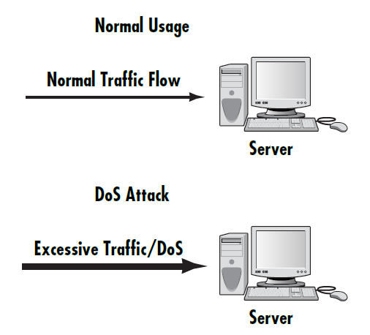
Denial of Service Attack
Based on the premise that all computers have operational limitations
Utilizes the ping utility to execute the attack
You can use the /h or /? Switch with ping to find out what options are available
Example:
ping [target] -1 65000 –w 0 -t
Notes:
Point out Figure 2 that illustrates a simple DoS attack.
Also point out that the actual execution of the Dos attack is much more complicated.
The example in the book uses the –w, -l (L) and –t switches to specify wait time, packet size, and timeout.

Slide 62
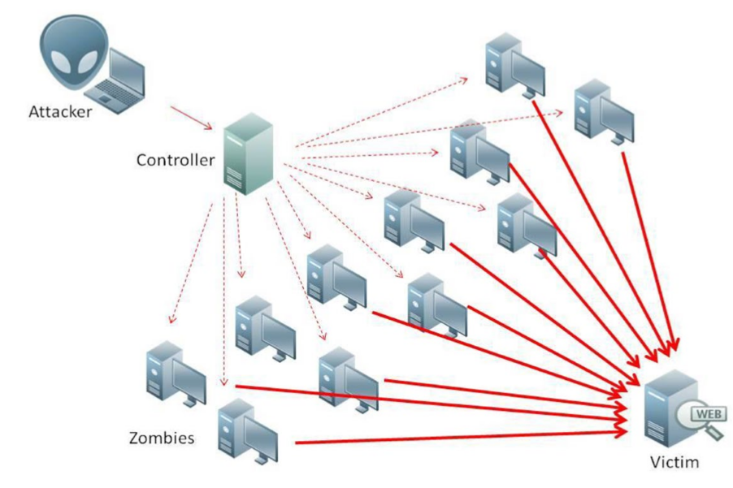
Distributed Denial of Service (DDoS) Attack
Variation of a Denial of Service
Launched from multiple clients
More difficult to track due to the use of zombie machines
Notes:
Explain the terms related to DDoS attacks (that is, Zombie machines).
Explain the general structure of a DDoS attack from the host (master launching the attack) to zombies to the target machine.

Slide 63
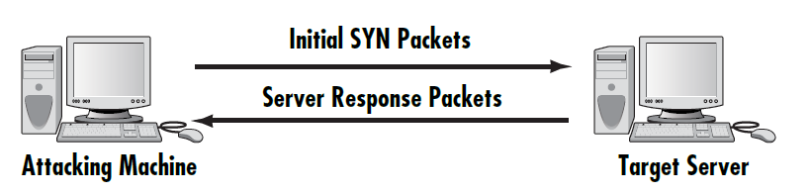
SYN Flood
Takes advantage of the TCP handshake process
Can be addressed in the following manners:
Micro Blocks
Bandwidth Throttling
SYN Cookies
RST Cookies
Stack Tweaking
Notes:
Explain the process of the SYN flood attack: The client does not respond to the server acknowledgment in the TCP handshake process.
Explain the defenses for the SYN flood, their weaknesses and strengths, and the difficulty level of configuring these defenses.
Explain the figure and how it demonstrates the SYN flood attack.

Slide 64
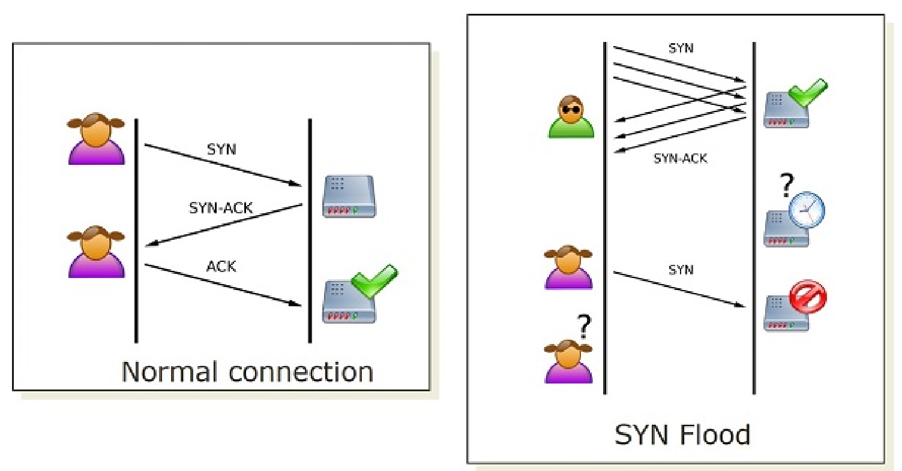
SYN Flood
Takes advantage of the TCP handshake process
Notes:
Explain the process of the SYN flood attack: The client does not respond to the server acknowledgment in the TCP handshake process.
Explain the defenses for the SYN flood, their weaknesses and strengths, and the difficulty level of configuring these defenses.
Explain the figure and how it demonstrates the SYN flood attack.

Slide 65
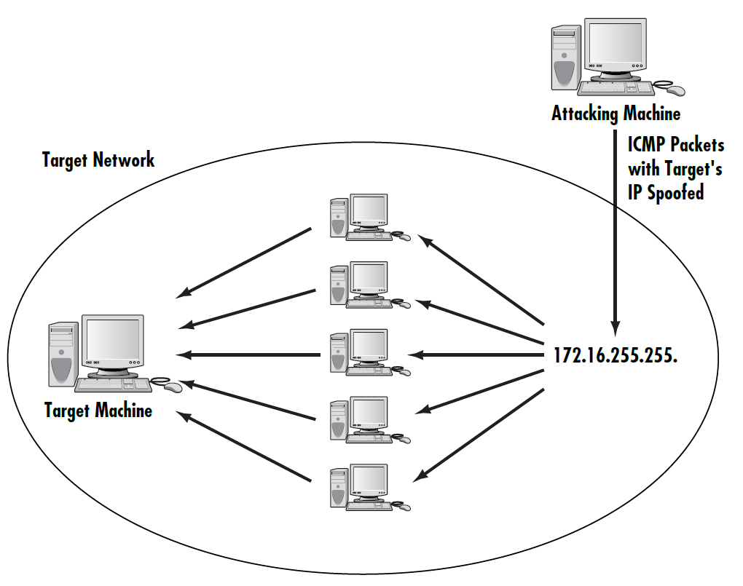
Smurf Attack
Very popular attack
Utilizes the ICMP packet to execute the attack
Notes:
Explain how the Smurf attack uses the ICMP packet to affect the target computer.
(The ICMP packet is broadcast on the network with an altered source address. The source address is the target or victim machine’s IP address.)

Slide 66
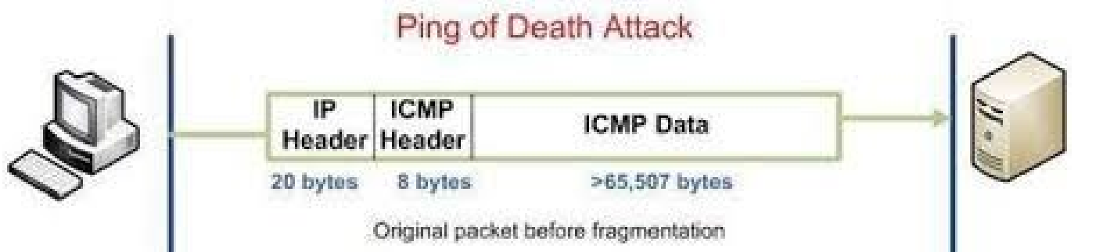
Ping of Death (PoD)
Attacks machines that cannot handle oversized packets (> 65,535 bytes)
Ensure that systems are patched and up to date
Most current operating systems automatically drop oversized packets

Slide 67
UDP Flood and ICMP Flood
UDP Flood
Variation to the PoD that targets open ports
Faster due to no acknowledgments required
Sends packets to random ports
If enough are sent, the target computer shuts down
ICMP Flood
Another name for the ping flood
Notes:
Explain the variations of the PoD attack: UDP and ICMP floods.

Slide 68
Distributed Reflection DoS (DRDoS)
Uses routers to execute the DoS attack
Routers do not have to be compromised in order to execute the attack
Configure routers to not forward broadcast packets
Notes:
Explain that routers use port 179 to communicate over the Internet backbone.
Also explain that packets are altered to have the target machine’s IP address as the source.

Slide 69
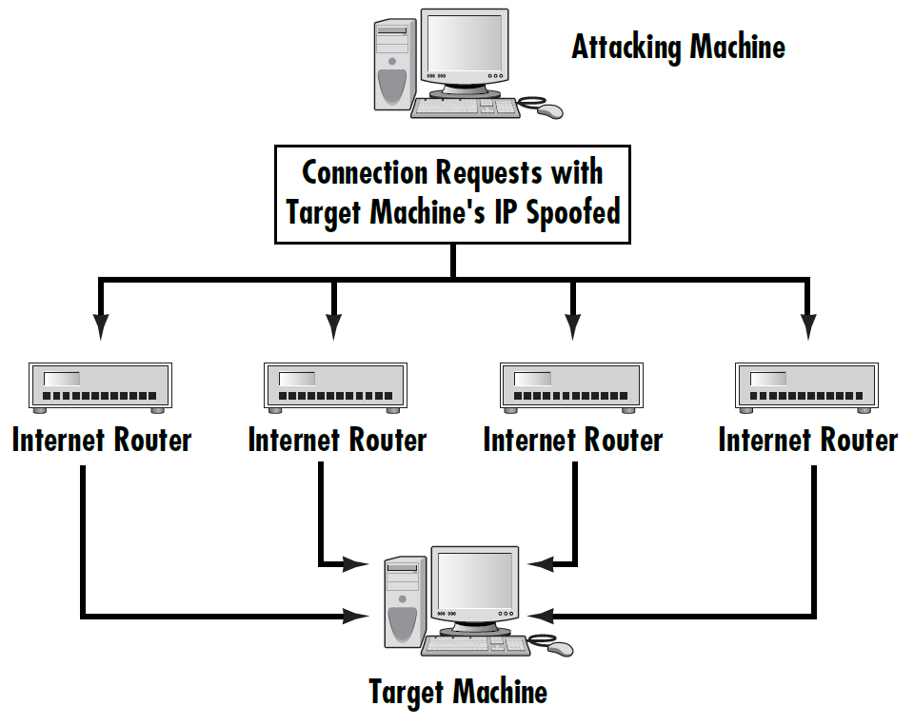
Distributed Reflection DoS (DRDoS)
Notes:
Provide examples of this kind of attack and the danger it poses by using the routers on the Internet.

Slide 70
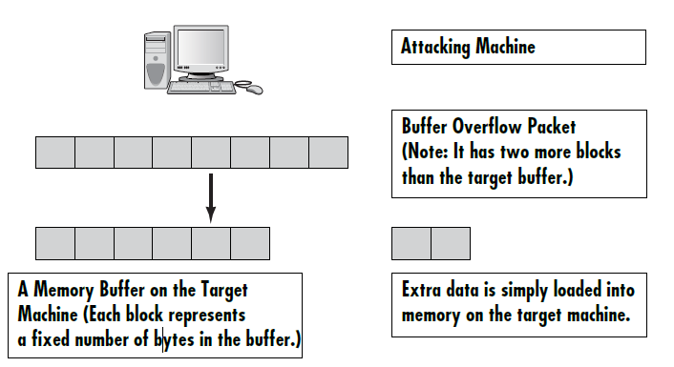
Defending Against Buffer Overflow Attacks
How do buffer overflow attacks occur?
What do script viruses have to do with buffer overflows?
Notes:
Explain how the buffer overflow works. Provide examples if you have them.
Also provide answers to the questions posed.

Slide 71
Viruses, Logic Bombs, Backdoors
Virus – malware that replicates when executed
Logic Bomb – a set of instructions secretly incorporated into a program so that if a particular condition is satisfied they will be carried out
Backdoor – covert method of bypassing normal authentication or encryption
Notes:
Provide other examples of viruses and what they tend to do.

Slide 72
Virus vs. Worm
Viruses and Worms both do malicious things
Viruses require human interaction to spread
Worms can spread without human interaction
Notes:
Explain these worms and attacks and their effects.

Slide 73
Trojan Horse Attacks
Program that looks benign but has malicious intent
They might:
Download harmful software
Install a key logger or other spyware
Delete files
Open a backdoor for hacker to use

Slide 74
How Do Viruses Spread?
Reads your e-mail address book and e-mails itself to everyone in it
Usually attaches itself to the victim’s existing e-mail software
Some viruses have their own e-mail engines

Slide 75
How Do Worms Spread?
Scans your computer for connections to a network
Copies itself to other machines in the network to which you have write access

Slide 76
Ransomware
A virus or other malware payload
Locks down the user’s files until they pay a ransom
WannaCry ransomware started in health care systems in the UK in 2017
Unpatched systems are most vulnerable

Slide 77
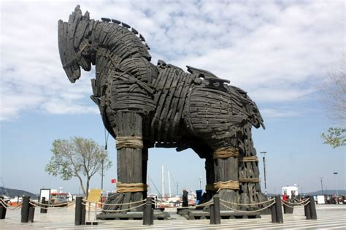
Trojan Horses
Typical actions Trojan horses take:
Delete files from a computer
Spread other malware
Use the computer to launch a DDoS
Search for personal information
Install “back door” to the computer
Notes:
Remind students that Trojan horses were described in Chapter 2, “Types of Attacks.”
Explain what a “dropper” is. (A Trojan horse that spreads other malware)

Slide 78
Symptoms of a Trojan Horse
Home page for your browser changes
Any change to passwords, usernames, accounts, and so on
Any change to screen savers
Changes to mouse settings, backgrounds, and such
Any device seeming to work on its own, such as a CD door
Notes:
Mention to students that these symptoms are assuming that you or another legitimate user are not making these types of changes.

Slide 79
What Ports are OPEN?
Windows
netstat –an
Mac
netstat –pant | grep ESTABLISHED
Unix/Bash
netstat –an | grep LISTEN

Slide 80
Single Loss Expectancy (SLE)
Calculates the impact a single loss will cause:
Asset value (AV)
Exposure value (EF)
Exposure factor is a percentage of the asset’s value that will be lost
SLE = AV x EF
$800 laptop, one year old, depreciation of 10% a year, 800 (AV) x 0.9 (EF) = $720

Slide 81
Annualized Loss Expectancy (ALE)
How much loss you can expect from a particular issue in a year
ARO = annual rate of occurrence
ALE = SLE x ARO
Example: if you estimate you will lose 6 laptops a year:
720 (SLE) x 6 (ARO) = $4320

Slide 82
Evaluating the Security Risk
How do you calculate Risk?
Attractiveness to attackers
Nature of information
Level of security
Each system receives a 1 to 10 score for each category
Notes:
Remind students that these aspects were discussed in Chapter 1, “Introduction to Network Security,” and assigned a value to determine the level of vulnerability of your system.
You might need to revisit the formula with students on how this is determined. See the next slide for the formula.

Slide 83
Evaluating the Security Risk
Attractiveness (A) to hackers
Information (I) content
Security (S)
Formula: (A + I) – S = Rating (R)
The lower the rating, the more secure the system
Notes:
Discuss how this formula works and provide examples of best and worst case security ratings.

Slide 84
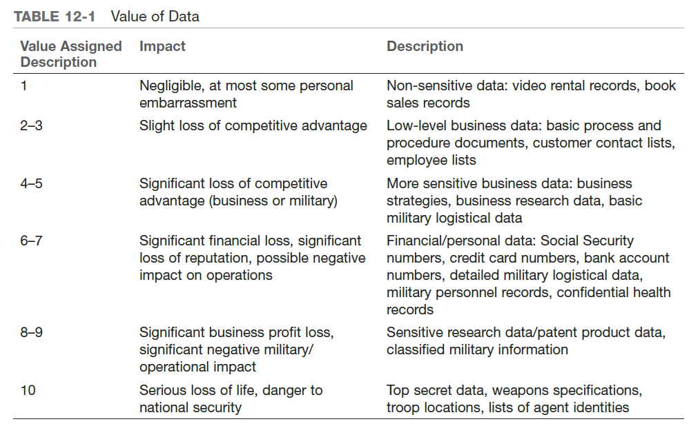
Evaluating the Security Risk
Notes:
Elaborate on this table with additional examples in each category.

Slide 85
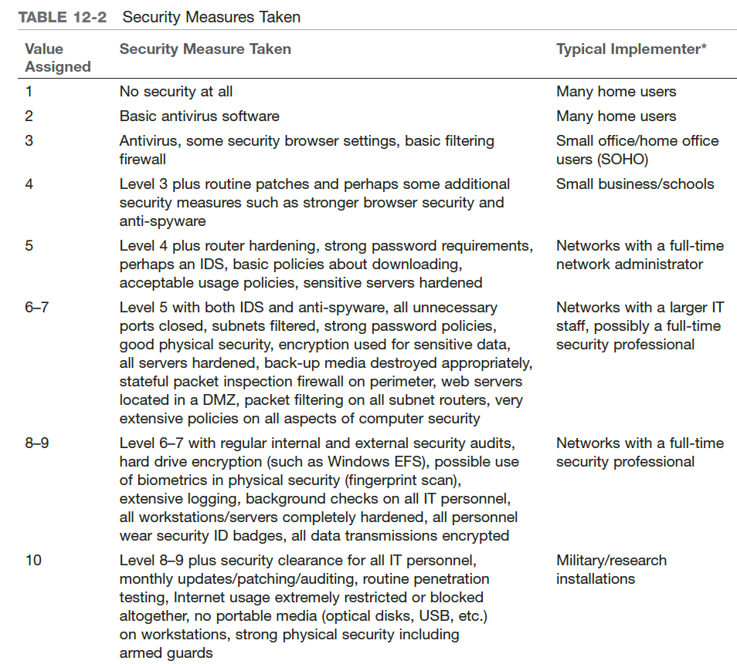
Evaluating the Security Risk
Notes:
Explain the contents of the table and fill in the additional information that is addressed in the book. You might provide additional examples of organizations in which you might see these levels of security.

Slide 86
The Six P’s of Assessment
(1) Patches
(2) Ports
(3) Protect
(4) Physical
(5) Probe
(6) Policies
Notes:
The next slides address each of these assessment factors.

Slide 87
(1) Patches
Patch policy
Must be written and followed
Applying patches
Must check all applications that require patches
Should be first on list of assessing the system

Slide 88
(1) Patches
Automated patch systems
Windows Update
HFNetChkPro
ZenWorks Patch Management
McAfee ePolicy Orchestrator
Notes:
Discuss each of these different types of patch management systems and how they can help maintain patches and service packs on systems.

Slide 89
(2) Ports
Common virus attacks come through specific ports
Close all unused ports to reduce vulnerability to specific virus attacks
Notes:
Reintroduce the concept of defense in depth.

Slide 90
(3) Protect
When assessing the protection of the network, ensure that the following are in place and functioning:
Firewall
Antivirus protection
Antispyware
IDS
Proxy server or NAT
Data transmission encryption
Notes:
Note that some experts say that a proxy server is critical. Also mention that if they are not configured properly hackers can use them to “bounce” signals off of to attack other systems. Proxy’s were also discussed in Chapter 2, “Types of Attacks.”

Slide 91
(4) Physical
Control access to:
Server rooms
Workstations
Miscellaneous equipment
Data backup media
Make sure physical equipment inventories are kept up-to-date

Slide 92
(4) Physical
Additional Physical Security Strategies
Biometric locks
All visitors to the building are logged in and escorted by an employee at all times
All bags are inspected
No portable devices that might record data are allowed on the premises
All printing is logged
All copying is logged similarly to printing
Notes:
Elaborate on each of these types of physical security measures and when they might be necessary to implement in your organization.

Slide 93
(5) Probing the Network
Port scanning
Scan well-known ports to see which are open
Enumerating
Try to determine what is on the target network (accounts, shares, printers)
Vulnerability assessment
Use of a tool to seek out known vulnerabilities or manually assess vulnerabilities

Slide 94
Vulnerability Lists
Common Vulnerabilities and Exposures (CVE)
Maintained by the Mitre Corporation
National Institute of Standards and Technology
Uses the CVE format
Open Web Application Security Project (OWASP)
The standard for web application security
They publish a number of important documents, including a Top 10 List

Slide 95
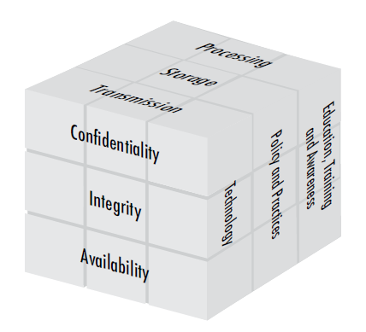
(6) Policies - McCumber Cube
Goals:
Confidentiality, Integrity, Availability
Information States:
Storage, Transmission, Processing
Safeguards:
Policy and Practices, Human Factors, Technology

Slide 96
(6) Policies - Security Documentation
Physical security documentation
Policy and personnel documentation
Probe documents
Network protection documents
Notes:
Elaborate on each of these types of documents in the next slides.

Slide 97
(6) Policies - Physical Security Documentation
List physical security that is in place
Document location of every device
If device is in a locked room, a list of who has keys should be kept
If entry logs are kept, copies should be kept with physical documentation
Notes:
Provide additional items relating to physical security as you see fit.

Slide 98
(6) Policy and Personnel Documentation
All policies must be filed
Revisions must be documented and kept
Signed copies of agreements on awareness
List of personnel with their access rights
Notes:
For the third bullet, this refers to the agreement you may have employees sign stating that they have received a copy of the policies and know what they are.
Add additional items as you deem necessary. This is not a comprehensive list.

Slide 99
(6) Policies - Probe Documents
Internal audit results should be filed every time
External audit results should also be kept
Follow-up reports if flaws are found
If a security incident occurs, document what happened and how it was corrected
Notes:
Provide additional points as you see fit.

Slide 100
(6) Policies - Network Protection Documents
These documents should detail the following:
What firewall is used and how it is configured
What IDS is in use and how it is configured
What antivirus/antispyware is used
Are honeypots in use
Are individual machine security measures in use and what are they
Notes:
Provide additional points as you see fit.

Slide 101
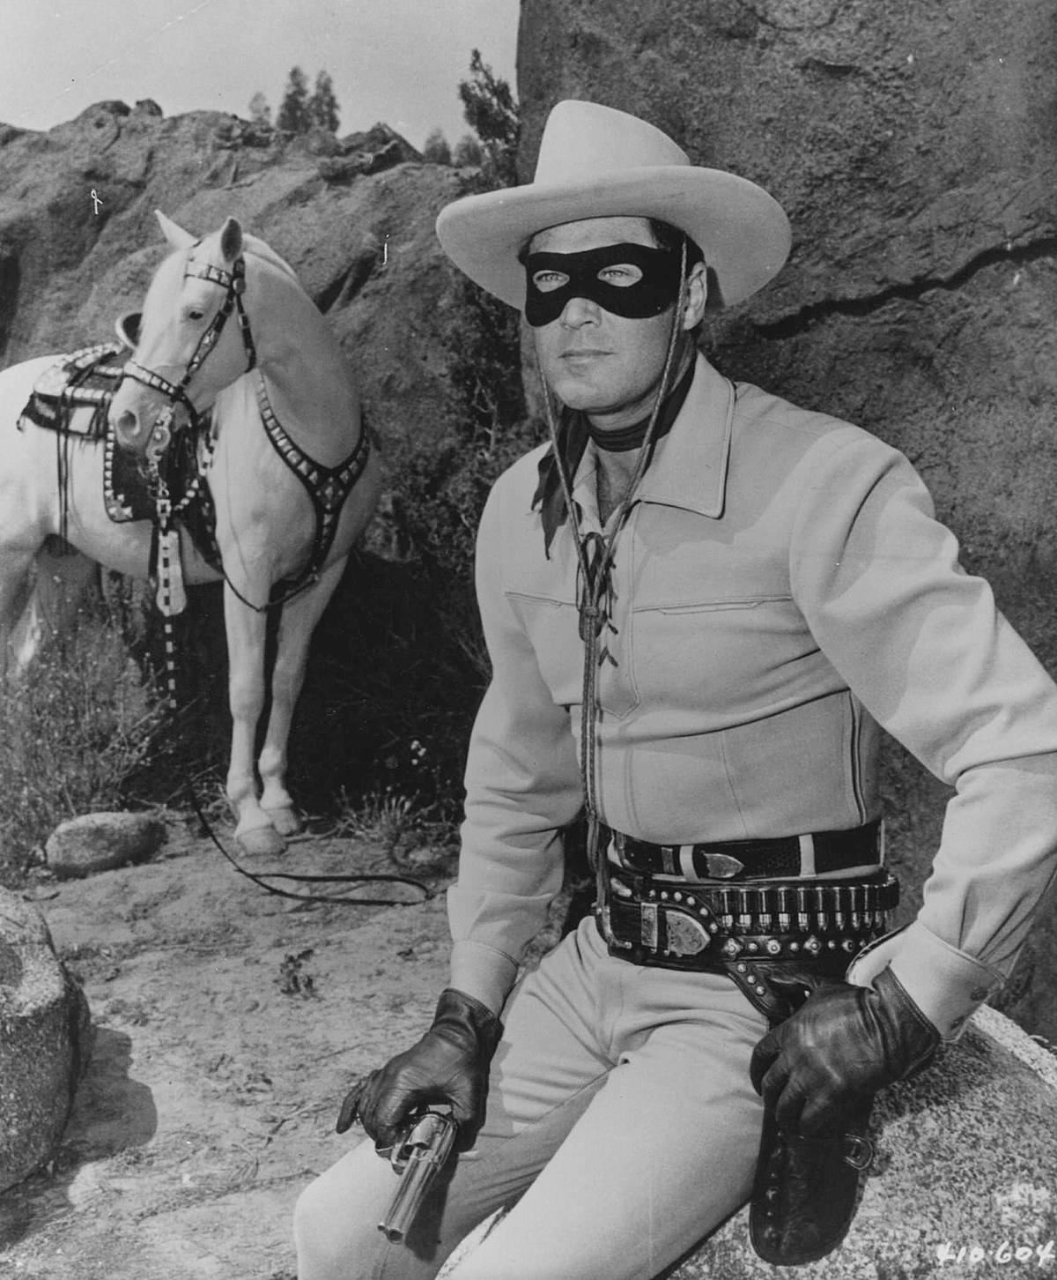
Types of Hackers
A white hat hacker is usually called a penetration tester today; It is someone who is hacking with permission of the owners of the target system
A black hat hacker is the person who gains access to a system in order to cause some type of harm; Black hat hackers are sometimes referred to as crackers
A gray hat hacker is normally a law-abiding citizen, but in some cases will venture into illegal activities

Slide 102
Penetration Testing (PenTester)
Also know as Ethical Hacker is some one that is AUTHORIZED to simulate a cyber attack against a computer or server.
Pen Testers are usually a company or security firm that performs several attacks on a company and provides a report to the company of any vulnerabilities found and how to fix any issues found.

Slide 103
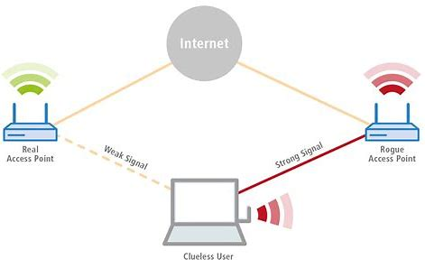
Evil Twin
Evil Twin is a fraudulent Wi-Fi access point that appears to be legitimate but is setup to eavesdrop on wireless communications.
The evil twin is the wireless LAN equivalent of a phishing scam

